Slide 1

DEPARTMENT OF ARTIFICAL INTELLIGENCE AND DATA SCIENCE
Presentation on
MODEL-BASED DECISION MAKING
By Mareddy Charan

Slide 2
MODEL-BASED DECISION MAKING
Model-based decision making, also known as prescriptive or decision analytics, is the practice of using analytical models to guide, justify, or automate decisions. It leverages historical and predictive insights to recommend the best course of action to achieve a specific goal, such as optimizing profit or minimizing cost.
It moves beyond knowing what happened (descriptive) and what might happen (predictive) to determine what should be done.
The primary goal is often optimization—for example, maximizing revenue, minimizing expenses, or maximizing customer response rates.
It provides a formal justification for a recommended action, supporting or replacing decisions based on intuition alone.
Models can either assist a human decision-maker or fully automate the decision-making process.

Slide 3
It has broad applications in business, including marketing, supply chain management, finance, and operations.
Successful real-world applications, as cited in publications like Interfaces, have been shown to save or generate millions of dollars.
Examples:
TurboRouter: A decision support system used by a shipping company for ship routing and scheduling, which reportedly generated $1-2 million in extra profit in just three weeks.
Ride-Sharing Surge Pricing: A ride-sharing app (like Uber or Ola) uses a prescriptive model to automatically set surge pricing in real-time. Instead of just reporting this imbalance, the model prescribes a solution. It automatically calculates and applies a specific price multiplier (e.g., "Set surge pricing to 1.5x"). This decision is designed to optimize two goals simultaneously: Increase Supply, Manage Demand

Slide 4
Prescriptive Analytics Model Examples
Modeling is a key and essential element of prescriptive analytics. For any realistic problem, such as one involving millions of customers, it is impossible to find the best decision manually. Therefore, a mathematical model must be employed to analyze all the variables and recommend an optimal decision that aligns with the business's goals.
Models are built to solve a specific problem by balancing an objective, which is the goal you want to achieve (such as "maximizing the overall response value"), with one or more constraints, which are the limitations or rules you must follow (like "staying within a budget"). There are many classes of models and specialized techniques available to solve these problems, and the application of these mathematical models is often what is referred to as data science.

Slide 5
Application: Marketing Promotion
The Problem: Deciding which customers (out of millions) should receive a specific promotional offer.
Model: A "probability-based response maximization model."
Outcome: The model provides the specific information (which customers to target) that maximizes the objective (response value) while respecting the constraint (the budget).
Environmental Analysis & Problem Identification:
No decision is made in a vacuum, so it's essential to analyze the scope of the domain and the forces and dynamics of the environment. This formal process, called environmental scanning and analysis, involves monitoring and interpreting collected information about factors like organizational culture and corporate decision-making processes. Business Intelligence (BI) and Business Analytics (BA) tools can help identify problems by scanning these environmental factors. It is critical that the problem is clearly understood and that everyone involved shares the same frame of understanding. This is because the problem will ultimately be represented by the analytical model, and if that model is based on an incorrect understanding, it will not help the decision-maker.

Slide 6
VARIABLE IDENTIFICATION: Identification of a model’s variables (e.g., decision, result, uncontrollable) is critical, as are the relationships among the variables. Influence diagrams, which are graphical models of mathematical models, can facilitate the identification process. A more general form of an influence diagram, a cognitive map, can help a decision maker develop a better understanding of a problem, especially of variables and their interactions.
FORECASTING: Forecasting, a form of predictive analytics, is an essential prerequisite for prescriptive analytics because knowing what is likely to happen is necessary for building and manipulating decision models. Since decisions are implemented to achieve results that occur in the future, models must be based on future-looking data; running "what-if" analyses on the past is pointless. The rise of online commerce has created both an immense need for rapid forecasting and an abundance of available information to perform it. This analysis goes beyond simply predicting demand; effective forecasting models analyze the entire situation, including product life-cycles and consumer behavior, with the ideal goal of leading to additional sales.

Slide 7
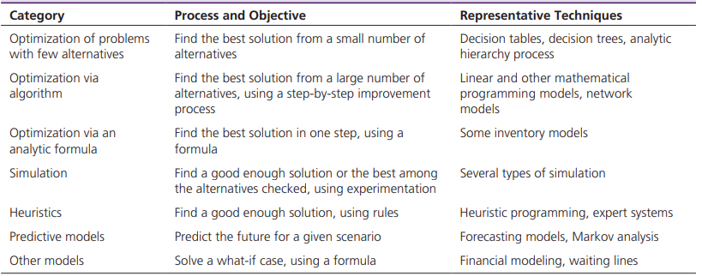
Model Categories: Decision models are classified into categories, such as static or dynamic, and are built under assumptions of certainty, uncertainty, or risk. To speed up model construction, analysts use special systems with embedded modeling languages, including spreadsheets, data mining systems, and OLAP tools.

Slide 8
MODEL MANAGEMENT: Models, like data, must be managed to maintain their integrity, and thus their applicability. Such management is done with the aid of model­-based management systems, which are analogous to database management systems (DBMS).
KNOWLEDGE-BASED MODELING: DSS uses mostly quantitative models, whereas expert systems use qualitative, knowledge­-based models in their applications. Some knowledge is necessary to construct solvable (and therefore usable) models. Many of the predictive analytics techniques, such as classification and clustering, can be used in building knowledge-­based models.

Slide 9
CURRENT TRENDS IN MODELING: Current modeling trends show a strong shift toward cloud-based tools and online model libraries (like the NEOS Server), making powerful optimization and simulation more accessible. Another major trend is making models completely transparent to the user, often through familiar spreadsheet or OLAP interfaces. While this simplifies use, it can also hide important solution details and limit the types of models considered. Despite this simplification, effective application for large-scale problems still requires experienced analysts and supporting infrastructure like data warehouses and parallel computing.

Slide 10
Thank you!

